Slide 1
SWEN Presentation ToR and Project plan
Done by: Vincent Tang | 1706416C
Aloysius Wee | 1707184F
Zhi Xuan | 1701380F
Haziq | 1704749I

Slide 2
Problem
The team has been tasked by the client to create a hotel management system in order to catch up in terms of technology with its competitors. The client owns a hotel in a fairly profitable location but however due to its lack of credibility from being a new competitor, it is also technologically inferior to its competitors. The hotel lacks a proper hotel management system that requires more employees to be hired than other hotels of its size and are still using the traditional keys compared to their competitors keycards.

Slide 3
Our proposed solution
After going through multiple iterations of the plan, the team has decided on creating a management system that makes use of mobile devices and the NFC system to create a more modern system to manage the hotel. Customers would be able to check in and out with their phones after an identity token is assigned to the guest’s smartphone . The guest can also request services such as room service from their smartphones at any point of time.

Slide 4
Features included
Mobile application
Unlock hotel room door
Check in and out of hotel
Easy access to customer services remotely
Ability to book taxi remotely

Slide 5
Assumption and constraints
Assumptions: Hotel is located in a competitive but lucrative district.
Check in and check out is handled by logs and guests are given keys to the hotels.
The team has their own working system and necessary programs installed on it.
Constraints: $400k budget with a 9 weeks time limit
Unable to meet on some days where some members of the group are busy

Slide 6
Resources
Hardware:
Computer with Windows operating system - Used for writing codes.
Mobile phone - Used for testing of the product.
Near field communication (NFC) - Usage of NFC is to be used at the room doors to grant access to NFC enabled mobile devices for identification and check in.
Software:
A coding platform ( Visual studio , Android studio )
A database- Database will contain guest’s information as well as unique NFC tags in order to be used in our system.
Cloud based storage

Slide 7
Marketing values
Priority of guest experience
Uses self service check in
Provide all guest service using hotel app
Uses smartphone to gain access to room

Slide 8
Approach and methodology
Chosen iterative model
Developed and tested in repeated cycle
More flexibility
Established required goals and understanding problem domain after incrementally put in codes

Slide 9
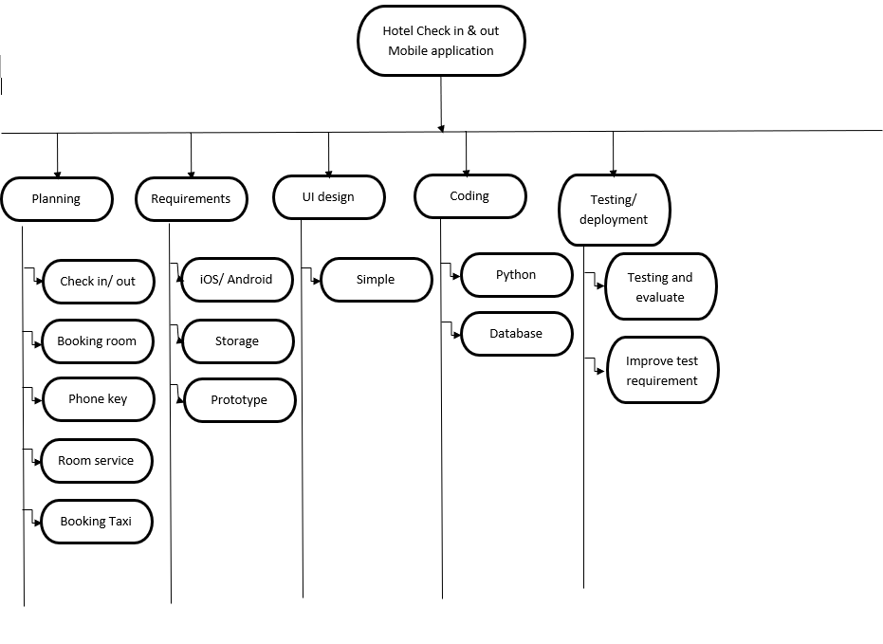
Work structure breakdown

Slide 10
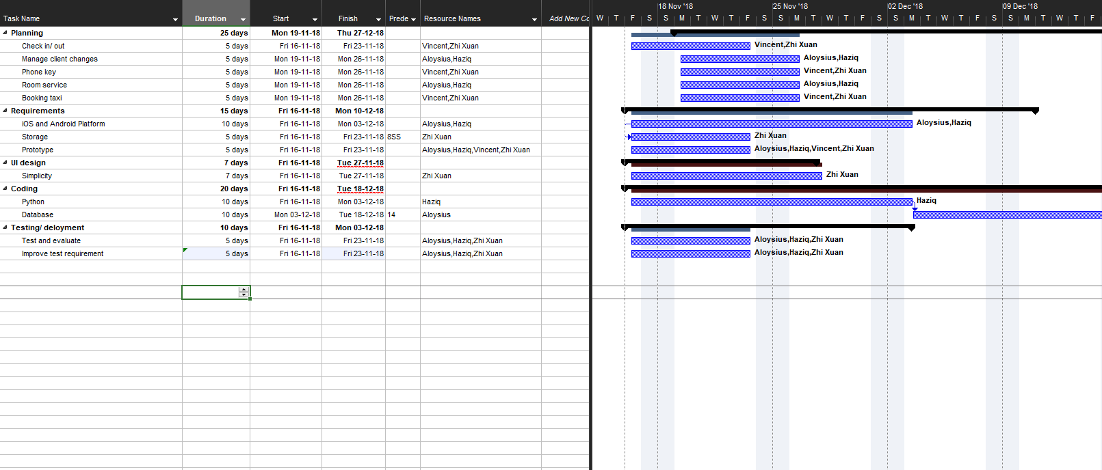
Project schedule

Slide 11
Budget Summary
Category | Description | Amount (S$)
Manpower | Graphics Designers | 18,000
 | Developers | 6,000
 | Testers | 3,500
Hardware | Self check in/out kiosk x5 | 2,500
 | Database server | 4,000
 | Enterprise desktop | 1,500
 | Mobile phone (iOS, Android) | 5,000
Software | Kiosk system software | 400
 | Windows server 2008 | 1,000
 | Microsoft Project | 1,159
 | Android studio | 0
 | Visual studio | 951
 | Swift (iOS) | 0
Total |  | 47,572

Slide 12
Risk Management
Type of Risk | Severity of Impact | Likelihood of Occurrence | Risk Exposure | Recommendation
Developer resign | High(3) | High(3) | 9 | Avoidance, ensure that the working environment is excellent and benefits will be given to employee who stays longer.
Power outage, server loss of power | High(3) | Medium(2) | 6 | Contingency, Install an additional source of power like uninterruptible power supply
Software developer hired not knowledgeable in their field | High(3) | Low(1) | 3 | Avoidance, increase the hiring requirement

Slide 13
System Requirement Specification
Done by: Vincent Tang
Aloysius Wee
Zhi Xuan
Haziq

Slide 14
System Functions
The first main function is, the system is a web interface for check in and check out running on self service kiosk, guest will be able to check in/ check out, make payments, edit room type all by themselves through the self service kiosk located at the lobby of the hotel.
Second main function is staff management module and reporting module, this system will allows for efficient tracking of staff management such as duty roster for the staff, clocking the amount of hours that the staff have worked.
The third main function is the mobile application for guest to access their room and getting room services after they have made payment for their services. Guest could easily download the hotel application for both iOS and Android devices. After downloading the application, it would require their login credential to use the services, the services from the application includes request for amenities like towels and toiletries to services like housekeeping and luggage assistance 24/7 during their stay in the hotel. This application also provide live chat with the hotel staff for other service that are not listed on the application.

Slide 15
Users Characteristic
User of this system should be able to check in/ check out of their rooms with the date/ time that they’ve book in advance or book on the spot. This system also allows guest to edit their check out date/ time however, subjected that there’s slot available. This system have two access level, guest and staff. Guest will have the access guest function and staff will have access to both guest and staff management functions. The guest should be able to do such function:
Make a room booking
Check in/ check out date
Room type
Confirmation
The staff should have the following management functions:
Edit guest booking
Change room type
Get guest information
Calculate changes for room type

Slide 16
General constraint
NFC System
Different type of mobile OS
Dependent on the taxi companies
Database size

Slide 17
Booking module (Check-in)
Main flow
Tap on self service kiosk | Kiosk screen should show home page
Guest to tap on check-in icon | Booking page will be displayed
Guest to choose their check-in and check-out date | Page will display chosen date and display amount for payment
Guest to proceed to made payment | Payment page will be displayed
Payment was successful | Kiosk will print out receipt with serial number for mobile application usage
Alternate flow (No room available)
Guest to choose their check-in and check-out date | Page display that no room available for that date. Pop-out message display to choose different room or date.
Alternate flow (Payment unsuccessful)
Guest to proceed to made payment | Card did not go through. Pop-out message display for guest to proceed to manual payment.

Slide 18
Housekeeping and staff management module
Main flow
Guest wants to clean the room, opens the app and selects housekeeping | Page displays housekeeping and state your request.
Selecting to room option | Page will ask for room number of guest
Notification is sent to guest when the room is done cleaning. | App will send a notification to the guest’s phone
Alternate flow (Guest flight is delayed/Baggage Claim delays)
Guest do not want their room to be clean by housekeeping. | Page will display options to of “Do not Disturb” or “Clean my Room”.
Guest can state the time they want the housekeeping to clean their room. | Page will display timing options.

Slide 19
Reporting module (Viewing all room status)
Allow management user to list all the room status in the hotel which are vacant, occupied or schedule for cleaning.
Main flow
1. | Management user login into the system
2. | System accepted username and password
3. | Management user clicks on generate report for room status
4. | System asked if a preview is needed
5. | Management user selects no
6. | System generate report of the list of room and their current status
Alternate flow
1a.1 | Management user is unable to login
1a.2 | Management user need to re enter password correctly

Slide 20
Convenience module (Booking a taxi from the hotel)
Main flow
Guest to call for taxi through app | Application screen should display from hotel or to hotel
Select the From Hotel option | Page will display destination , estimated cost.
Confirm booking and payment method. | Page will display payment methods ( Cash, Credit/Debit Card)
Booking successful | Page will display estimated time of arrival for taxi
Notification is sent to guest when taxi has arrived | App will send a notification to the guest’s phone
Alternate flow (Guest did not board the taxi after 5 minutes.)
Notification would be made to the main desk. | Main desk would be alerted.
Main desk would call up the hotel room | Phone in the hotel room would ring informing the guest that the taxi has arrived.

Slide 21
Data Requirement
Staff
Name | Name of staff member
Department | Where staff is working at
Salary | How much is the salary

Slide 22
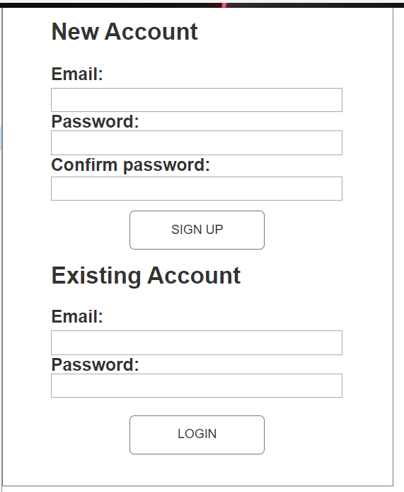
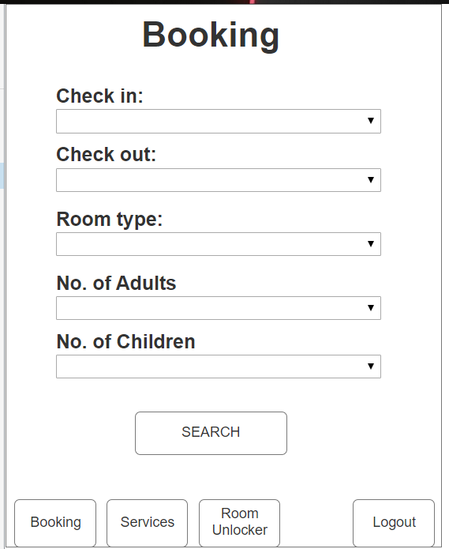
User interface

Slide 23
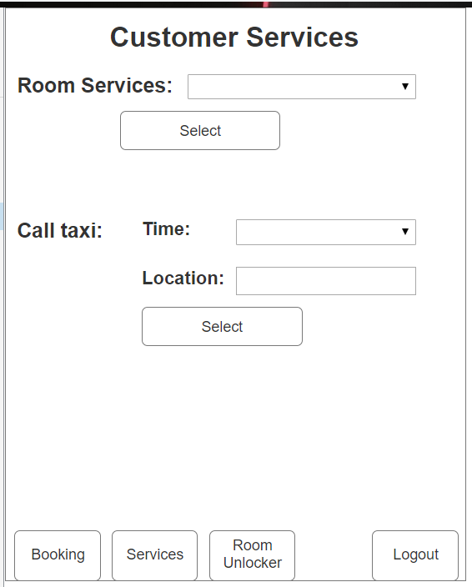
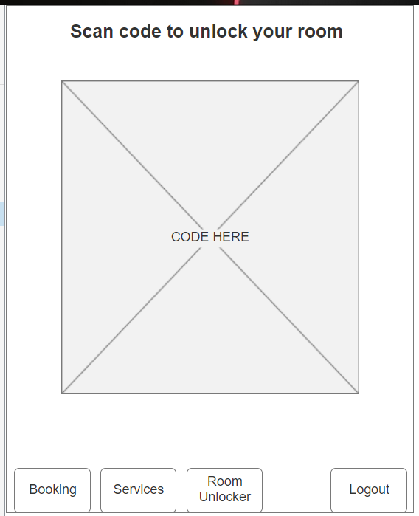
User interface

Slide 24
Assumptions
We assumed that the current computer is Pentium 4 running on the Windows XP Support Package 2 operating system. It has a 1GB ram and a 160GB hard disk. It is connected to the internet via a broadband connection. Due to the limited budget the system would not need to be integrated into existing systems.

Slide 25
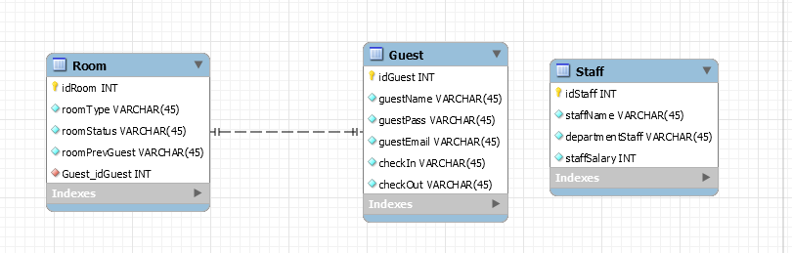
Software Database Design

Slide 26
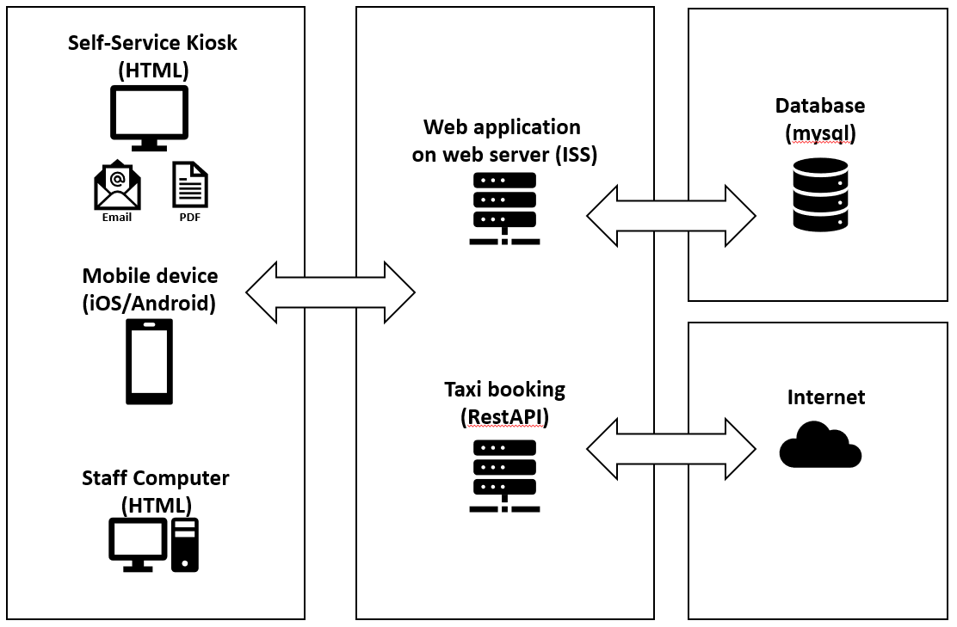
Architecture Design

Slide 27
User Interface Design(Mobile)
This is the home page, this is what the customer first sees when the load up the application for the first time.
There is two option here, first option is for new customers where they sign up to use the application.
Second option is for existing customer where they already have an account but logged out previously.
As the application needs a user account before the customer can access the hotel’s features, most features like booking a room, room services will be locked until the login with a valid account.

Slide 28
User Interface Design(Mobile)
This is the booking page that appears when after user logins into the mobile application. For the both the check in and check out selection, a calendar pop out will be used to select the dates. The reason for this is that the user would not have to manually enter the date that they are checking in and out, making it less troublesome and more convenient for the users. As for the room type, a drop down list will be used instead as room type have only two options compared to dates, for example, standard and premium. The selection for number of adults and number of children will also be using a drop down list using the range of 0-3 for both. The reasoning behind this is that we do not expect that many people using a single room by itself as each room will only have two beds at most, along two floor mattress if needed.

Slide 29
User Interface Design(Mobile)
This is the services page that mobile application users will see after they have selected and confirmed a room of their choosing.
As the application recognise which room the customer have booked, all of the services will be linked to that particular room.
Room services options are chosen using a drop down list. The call taxi function works by first select a time that the customer want the taxi to arrive follow by the location where the taxi is arriving.
Fees will be automatically added to the customer’s bill when the check their bill.

Slide 30
User Interface Design(Mobile)
The is the room unlocker page, the special feature of this application.
Customer simply need to scan this code with the room’s scanner.
The code is in big enough that the scanner is able to scan it properly.
As with the services page, this code is unique to each customer and will only unlock the rooms that they have booked, it will not work with any other rooms.

Slide 31
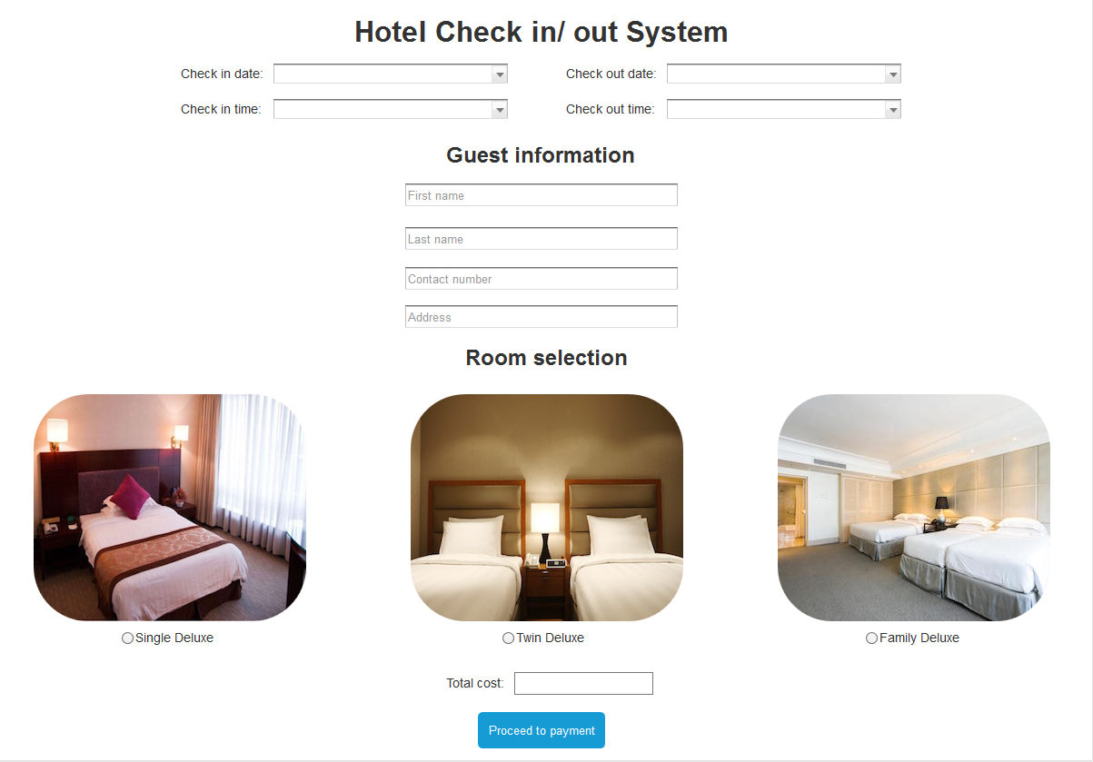
User Interface Design (Web application)

Slide 32
PROGRAM DESIGN
Normal Flows: 1. Register user’s information. 2. User will choose which types of room that are available in that hotel. 3. User will select date for their stay in that hotel.. 4. View availability of rooms. 5. User select and confirm booking. 6. User can check in into the hotel through the application on the day of checking in. 7. User can check out of from their room by using the application. Alternative flow: 4a. Rooms fully booked, user must choose other dates of booking. 5a. User will receive a confirmation reservation email or text message from the hotel.
Use case Name: Hotel Check In and Check Out
Actors: User, Hotel administrator
Trigger: User wants to make online booking through the application
Preconditions: The users can make an online booking of hotel rooms if the room is available and the users can check in and out of the hotel rooms by using the application once the room is ready and to check out on the day and time they have selected

Slide 33
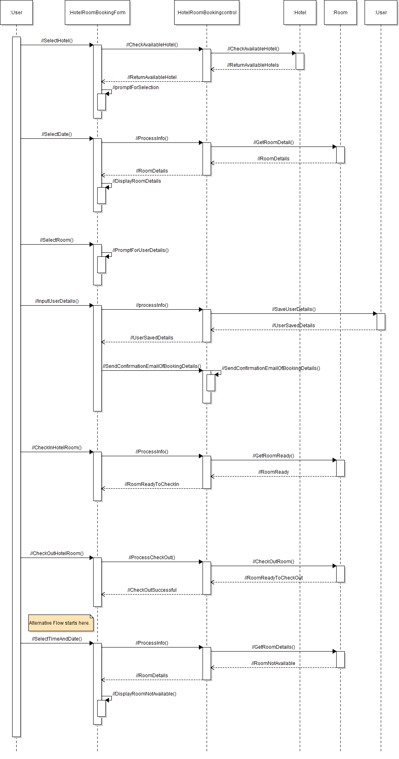
Program Design

Slide 34
Database Design

Slide 35
Unit testing
Booking module
Web project nowadays is very different and has different requirements. No software out there has all the necessary features out of the box, so when it comes to special client requirements we have to develop new module development and unit testing to custom made for this software. My team have use naming convention (camel case) in our code to allow us to easier understand which code is used for what purpose. Example we will be using the first few letters of the name is used to denote the type of the word. We used our self developed testing methodologies to test our software as it allows us to customise for our own software.

Slide 36
Housekeeping and staff management module
My team use getter and setter methods for code refactoring.
Getter and setter method is to be able to see the username and room number of the guest.
For the staff management we use the naming convention (camel case) the roster system.
Staff names by two names joined together as one compound word.
Staff could select the name of staff to view their roster

Slide 37
Convenience module
The naming convention the convenience module will be using the the camel case.
Examples of it would be taxiTime, taxiStatus, taxiPrice.
We have used code refactoring to refactor the codes that was part of the api given to us by the taxi companies.
We have refactored the code so that the design of the api better fits our system.

Slide 38
Reporting module
The variable naming convention are done using camel case, for example, UserName and Password where the beginning letter is uppercase.
Normal data is input such as the right UserName, John and Password, pass123, the system will display the next page
Abnormal data is input such as ÑσAÑ░├ for password, the system will display a “password not accepted” message.

Slide 39
System integration
System integration is done using GitHub.
When the software modules from different team members are done, it can be uploaded onto the GitHub repository during the integration phrase.
This ensures that all the different modules are kept in a single location, rather than having multiple links for different modules.
Team members create a account to be able to push codes into the repository
Those without account are only able to download but not edit or delete the codes

Slide 40
Test cases
S/No | Steps | Test Data | Expected Results | Actual Results | Remark
1 | Guest to choose their check-in and check-out date | Checkin: 24/07/2019 Checkout: 26/07/2019 | Page will display room and total amount | Page will display room and total amount
1a | System shows that chosen date have no room available | Checkin: 24/07/2019 Checkout: 26/07/2019 | Page will display: Sorry no room available for selected date | Page will display: Sorry no room available for selected date
1b | System informed that user key in wrong date format | Checkin: 24/07/2019 Checkout: 32/07/2019 | Page will display: Please check date format | Page will display: Please check date format

Slide 41
Test cases
S/No | Steps | Test Data | Expected Results | Actual Results | Remark
1 | System accepted username and password | UserName: John Password: pass123 | Generate report for room status page will displayed | Generate report for room status page will displayed
1a | System does not accept password | UserName: John Password: 321pass | System display wrong password popup | System display wrong password popup
1b | System does not have record of user | UserName: Mary Password: pass456 | System display no such user found | System display no such user found

Slide 42
Reflections
Vincent Tang Jian Wei This module has helped me to understand how a major project like creating a new system is being slowly built up with the appropriate documentation and research to support those documentations.
Ong Zhixuan The module has helped me understand the development process of a system from the start to the end and the various ways of implementing it. The course has also shown me ways to plan and set up and work as a team .

Slide 43
Reflections
Ikhwan Haziq Bin Sinwan This module has helped me experience on how to find a solution for the Hotels to provide their guest straightforward application where we have to create and find ideas before we program the application. This module has taught me how to improve the system by reducing man power and all can be done by technology.
Aloysius Wee Zi Xiang Through this module, I have learnt that designing a software from scratch requires lot of careful planning. By using the best model for different type of business approach will have a more efficient and productive outcome. It also makes me wonder now that what type of business model current application are using, such as Uber, Twitter etc.

